Slide 2
Memory Segmentation
8086 is able to address 1M bytes of physical memory
Physical memory is divided into a number of logical segments
1M of physical memory is divided into 16 logical segments
Each segment = 64 K bytes
16 bit address in segment register point to the starting address of a segment
16 bit address in offset register point to the specific memory location within a segment
Starting address of offset register is 0000 H and Maximum value of offset address is FFFF H
Segment register may go from 0000 H to F000 H
Hence, the range of physical address is 00000H to FFFFFH
This kind of segmentation is called non overlapping segments
It supports overlapping segments as well.

Slide 3
Advantages of segmented memory
Though the memory capacity is 1M bytes, 16-bit memory addressing is sufficient to access data in memory
Code, data and stack portions of the same program can be placed in different segments for data and code protection
Permits a program and its data to be placed in different parts of the memory each time the program is executed - relocation

Slide 4
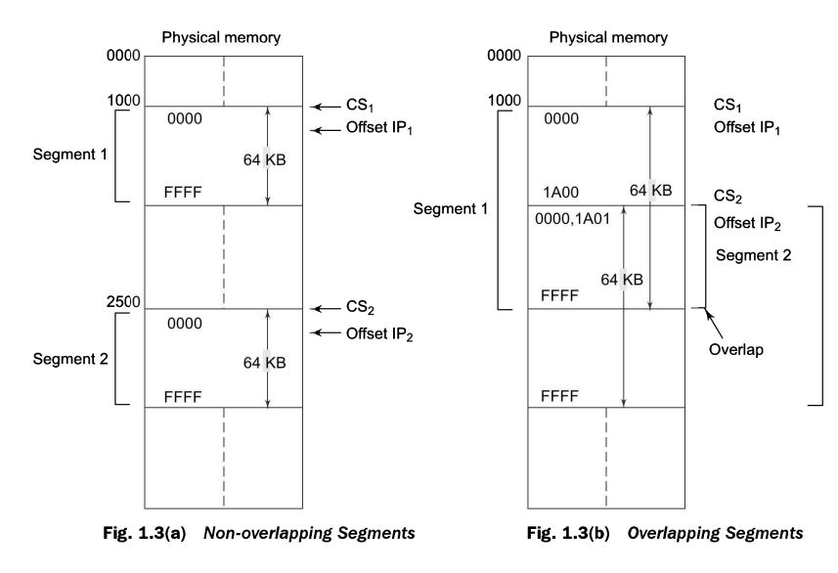

Slide 5
Flag Register
16-bit flag register - a) condition code or status flags and b) machine control flags
Condition code flag register
- lower byte of the 16-bit flag register along with the overflow flag
- reflects the results of the operations performed by ALU
Control flag register
Higher byte of the flag register
Direction flag, interrupt flag, trap flag

Slide 6
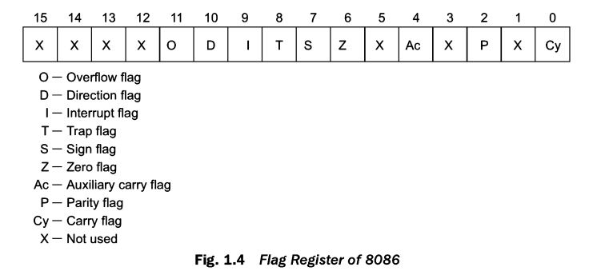

Slide 7
Sign flag - Set when the result of any computation is negative.
For signed computations, the sign flag = MSB of the result
Zero flag - Set if the result of the computation or comparison performed by the previous instruction(s) is zero
Parity flag - Set if the lower byte of the result contains even number of 1’s
Carry flag - Set when there is a carry out of MSB (addition) or borrow(Subtraction)
Trap flag - On setting this flag, processor enters the single step execution mode.
After the execution of each instruction, a trap interrupt is generated and the control is transferred to Trap Interrupt Service Routine.

Slide 8
Interrupt flag - If this flag is set, the maskable interrupts are recognised by the CPU, otherwise they are ignored.
Direction flag - used by string manipulation instructions,
If DF = 0, the string is processed from lowest address to highest address, auto incrementing mode
If DF = 1, the string is processed from highest address to lowest address, auto decrementing mode
Auxiliary carry flag - set if there is a carry from the lowest nibble or borrow for the lowest nibble
Overflow flag - set if an overflow occurs, (if the result of a signed operation is large enough to be placed in a destination register

